Slide 1
Packing puzzle problem
With reinforcement learning
Martin van der Schelling and Alex Xiaole Jiang

Slide 2
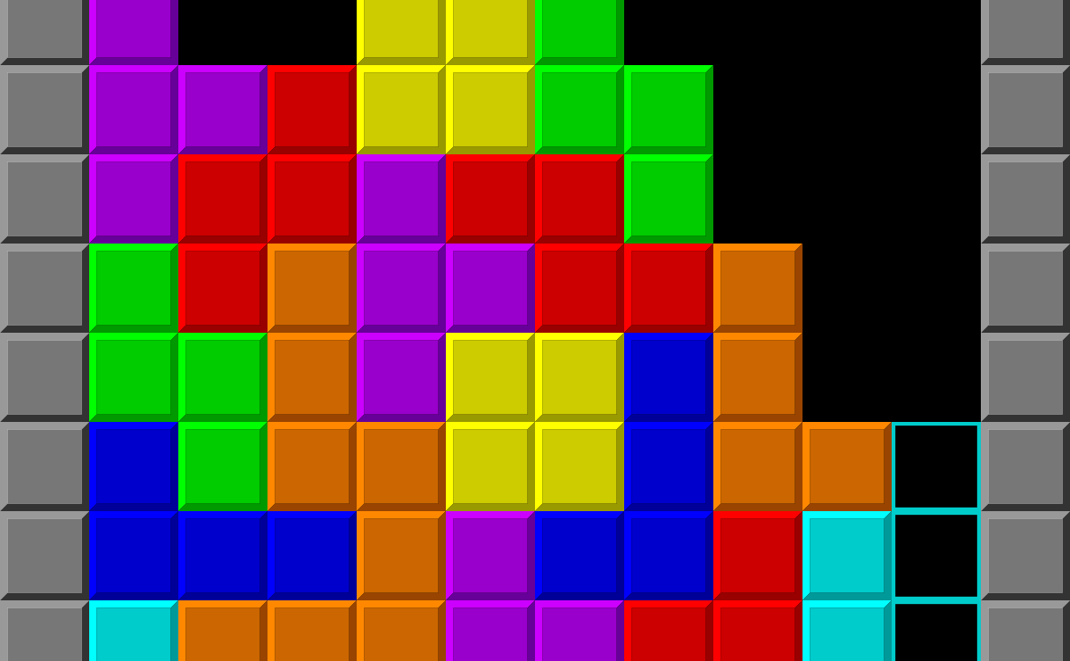
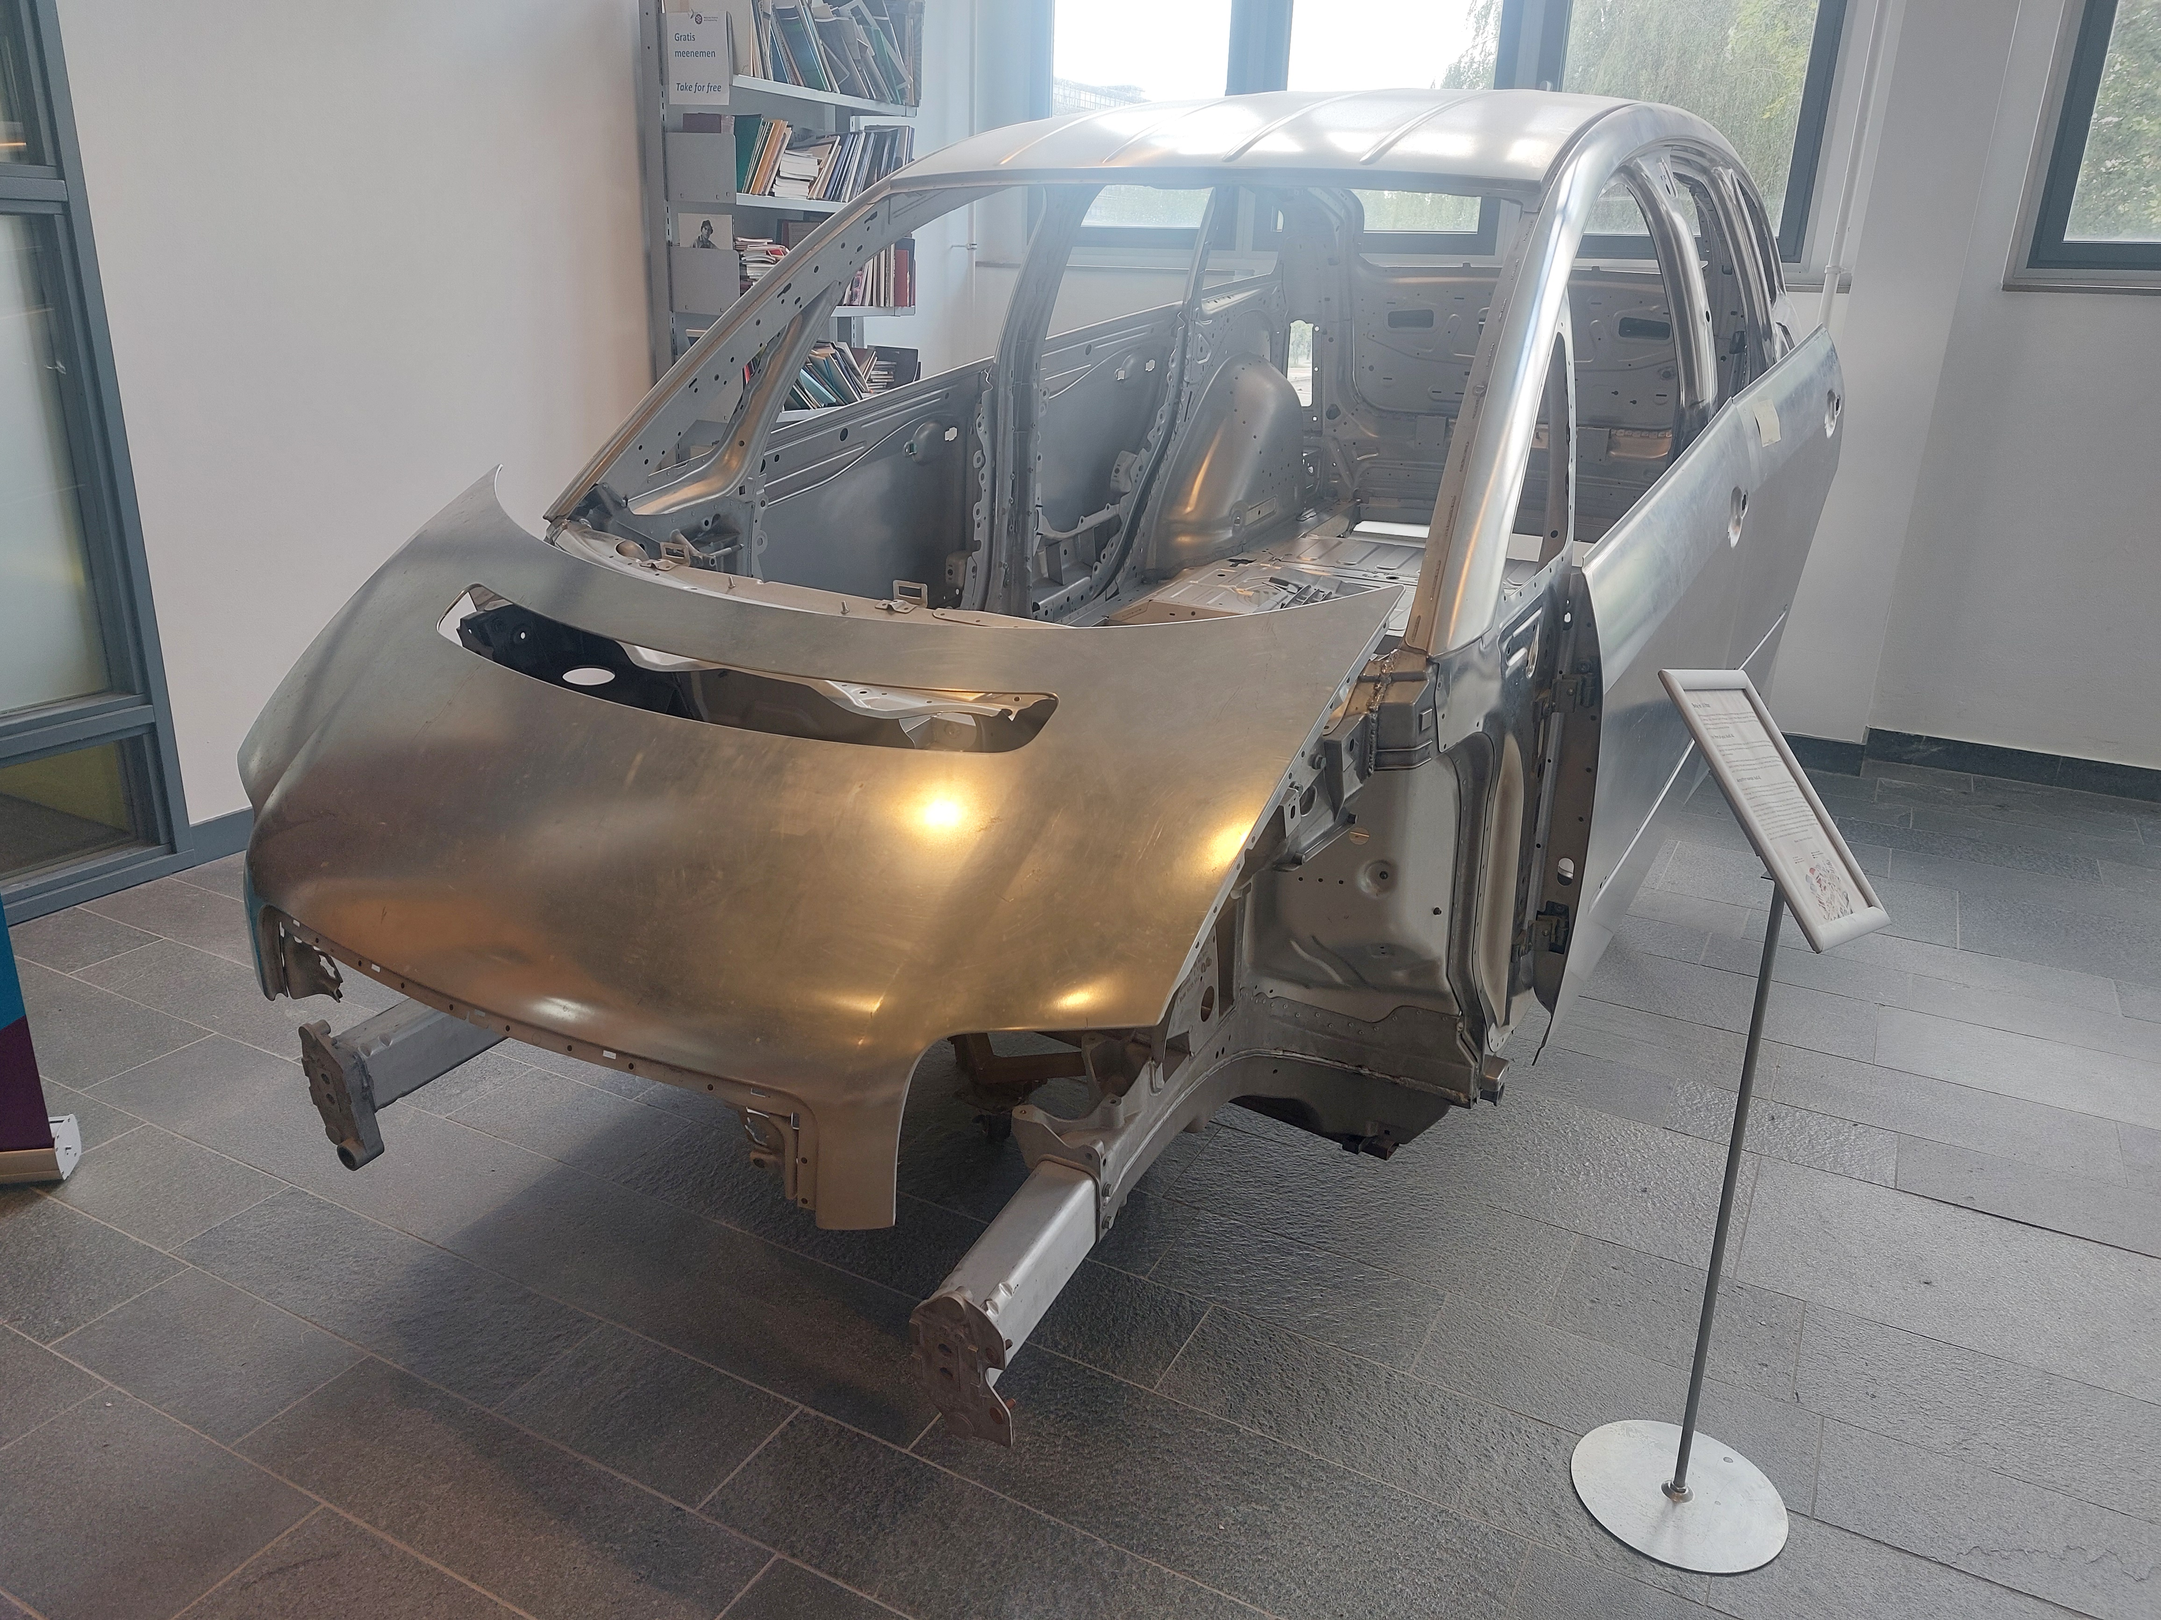
Motivation
Modern applications need materials and structures with complex shapes and properties
Reuse existing structures

Slide 3
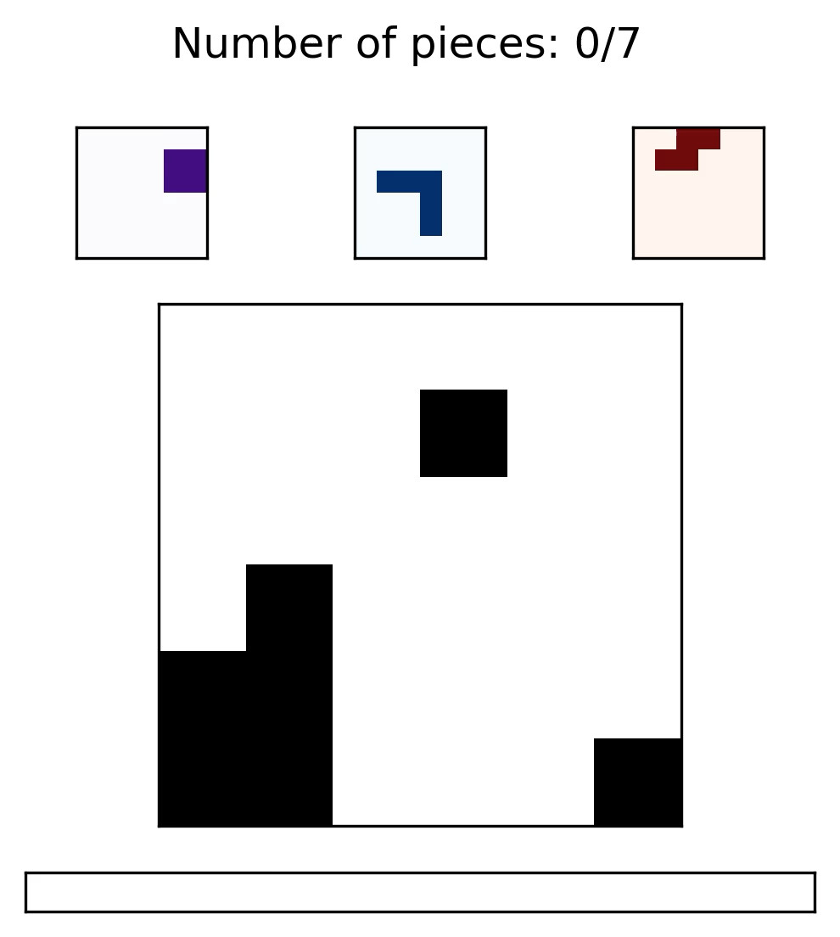
The Setup
Observation
Current grid (n, n)
Next piece (n, n)
Remaining pieces (p – t, n, n)
Action
Translate the next piece horizontally and vertically
Reward
White pixel = -1,
Black pixel = 0
Block adds value 1 to the pixel
Out-of-bounds: +1
Reward proportional to minimizing the sum of absolute value of all pixels
N = grid_size
P = number of pieces
T = timestep

Slide 4
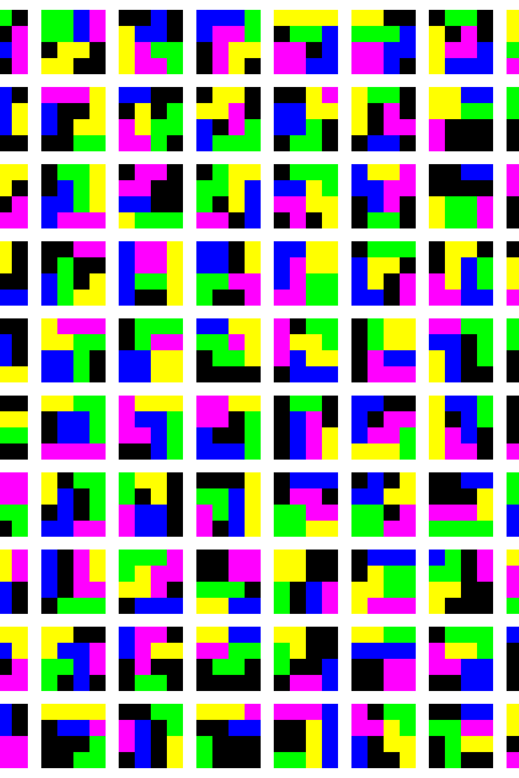
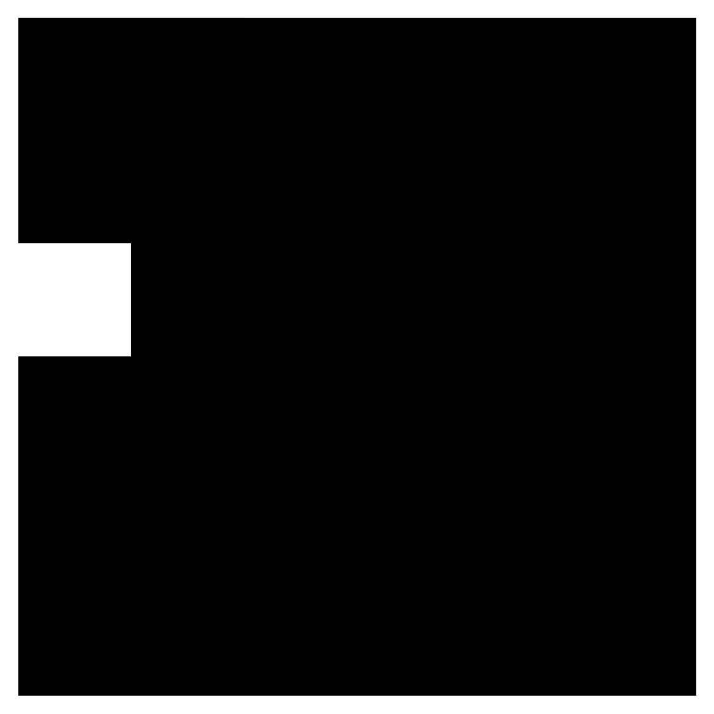
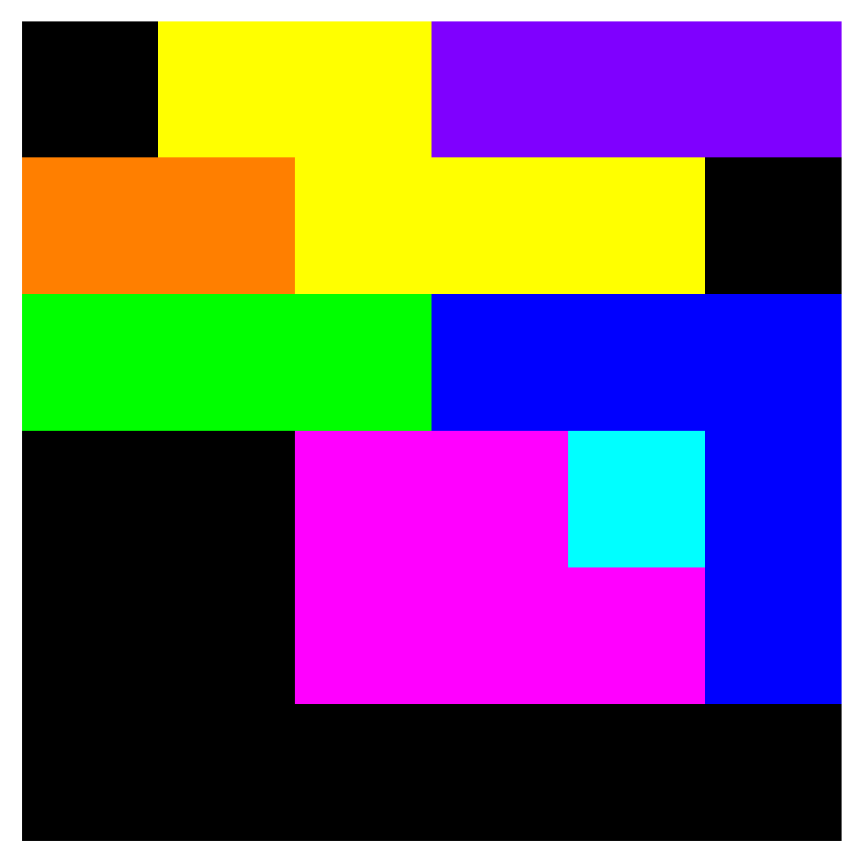
Generating puzzles
Set a grid_size
Choose the number of pieces and their minimum and maximum size

Slide 5
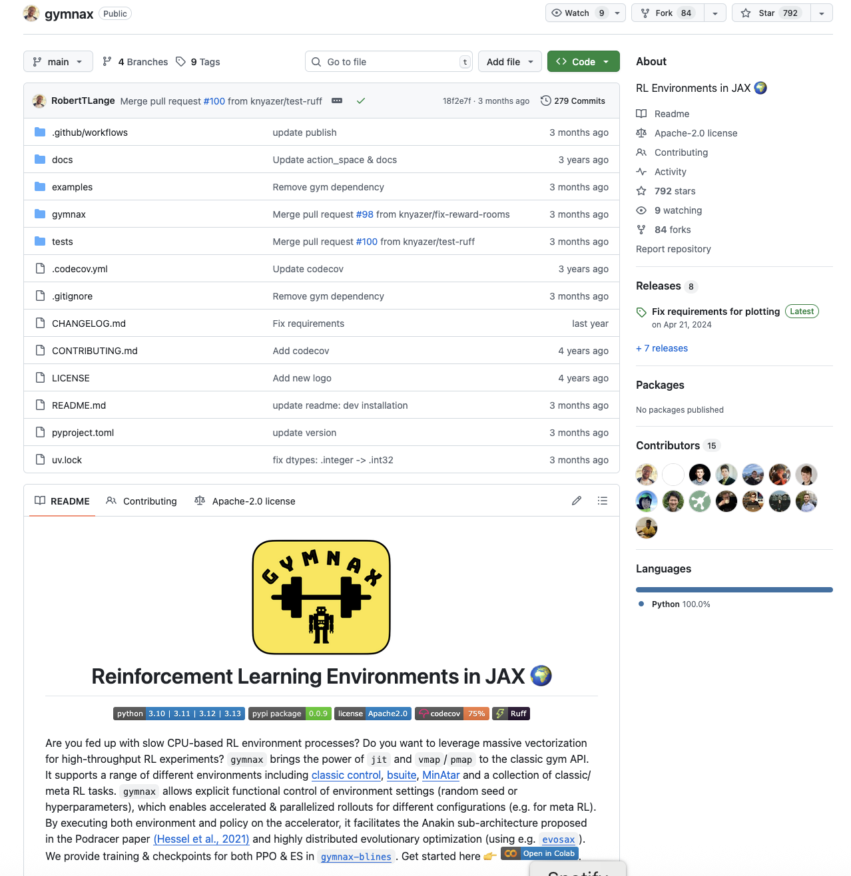
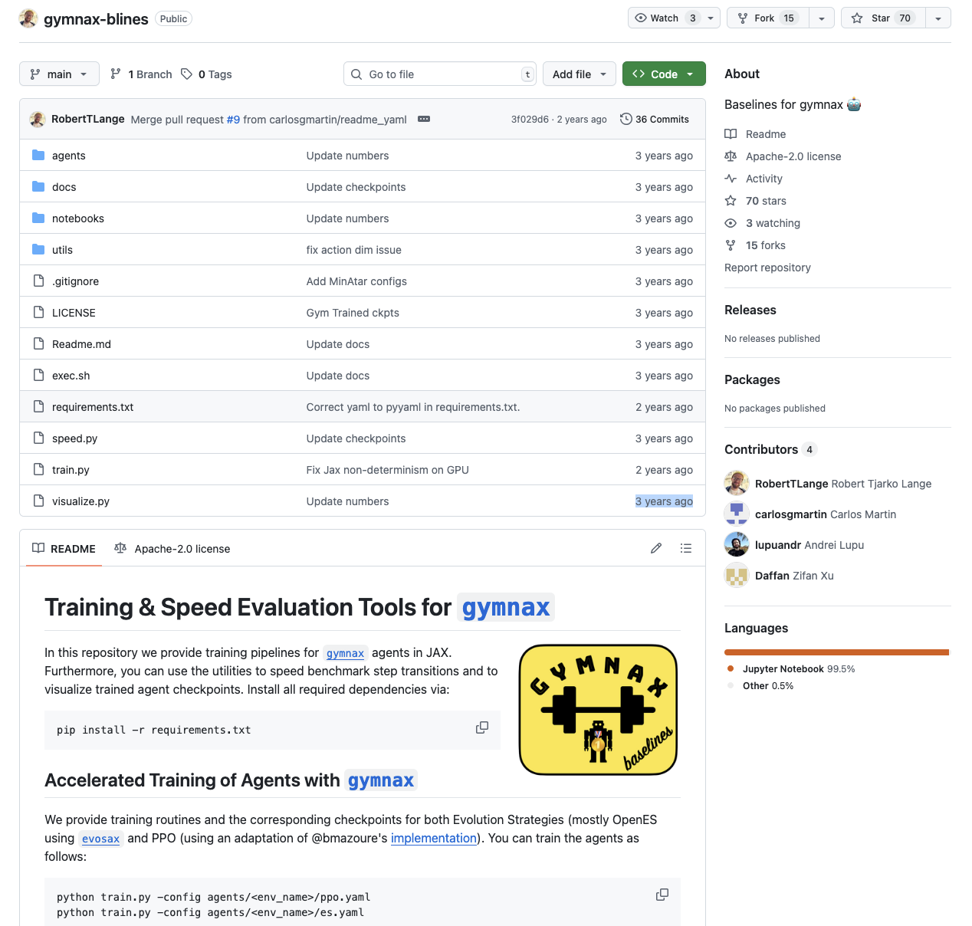
Implementation
PPO baseline
Policy model: 2 layer MLP with 64 hidden units
Adam optimizer
Warm-up where lr=5e-2
Entropy coeff: 0.01
Discount factor: 0.99
Critic coeff: 0.5
GAE lambda: 0.905
Gymnax: Standardized OpenAI gym interface, implemented in jax
Gymnax-blines: PPO benchmark algorithm
gymnax
gymnax-blines

Slide 6
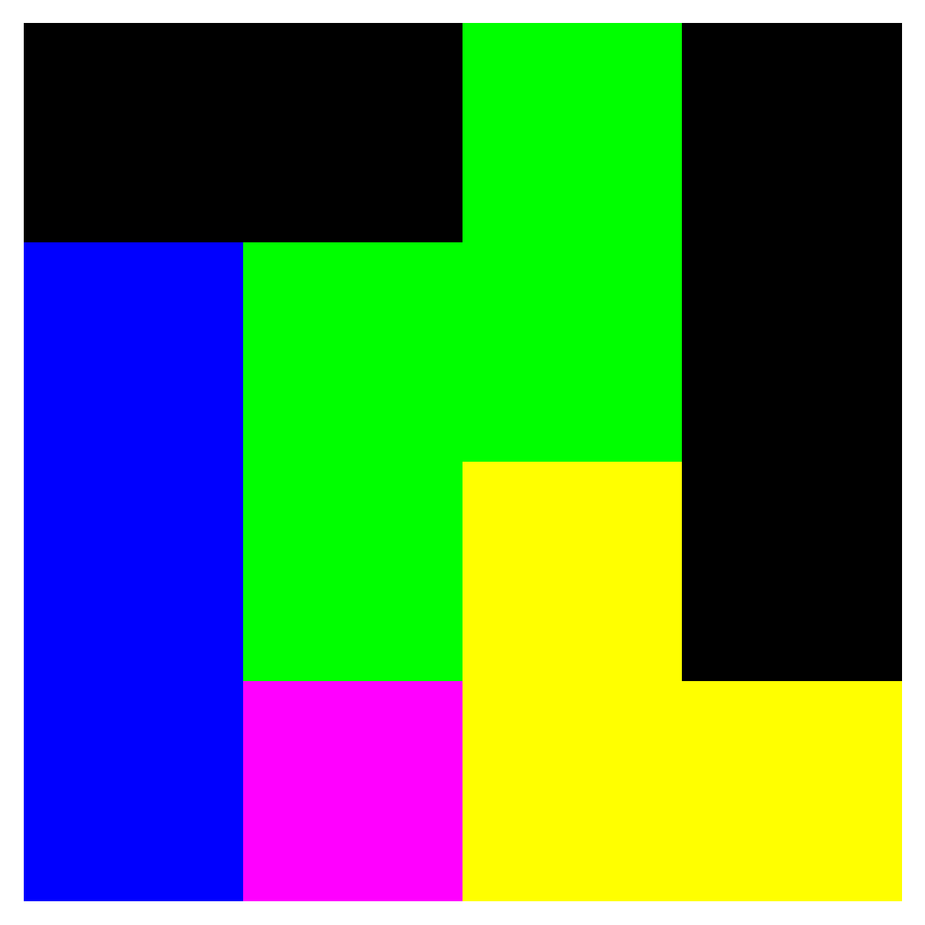
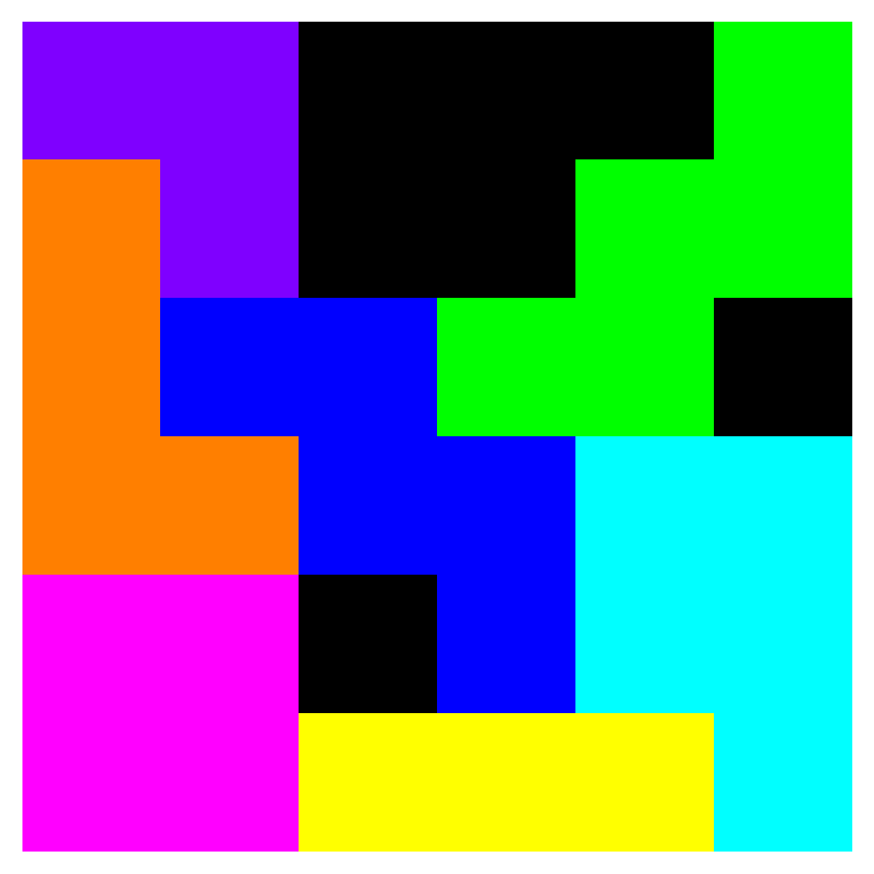
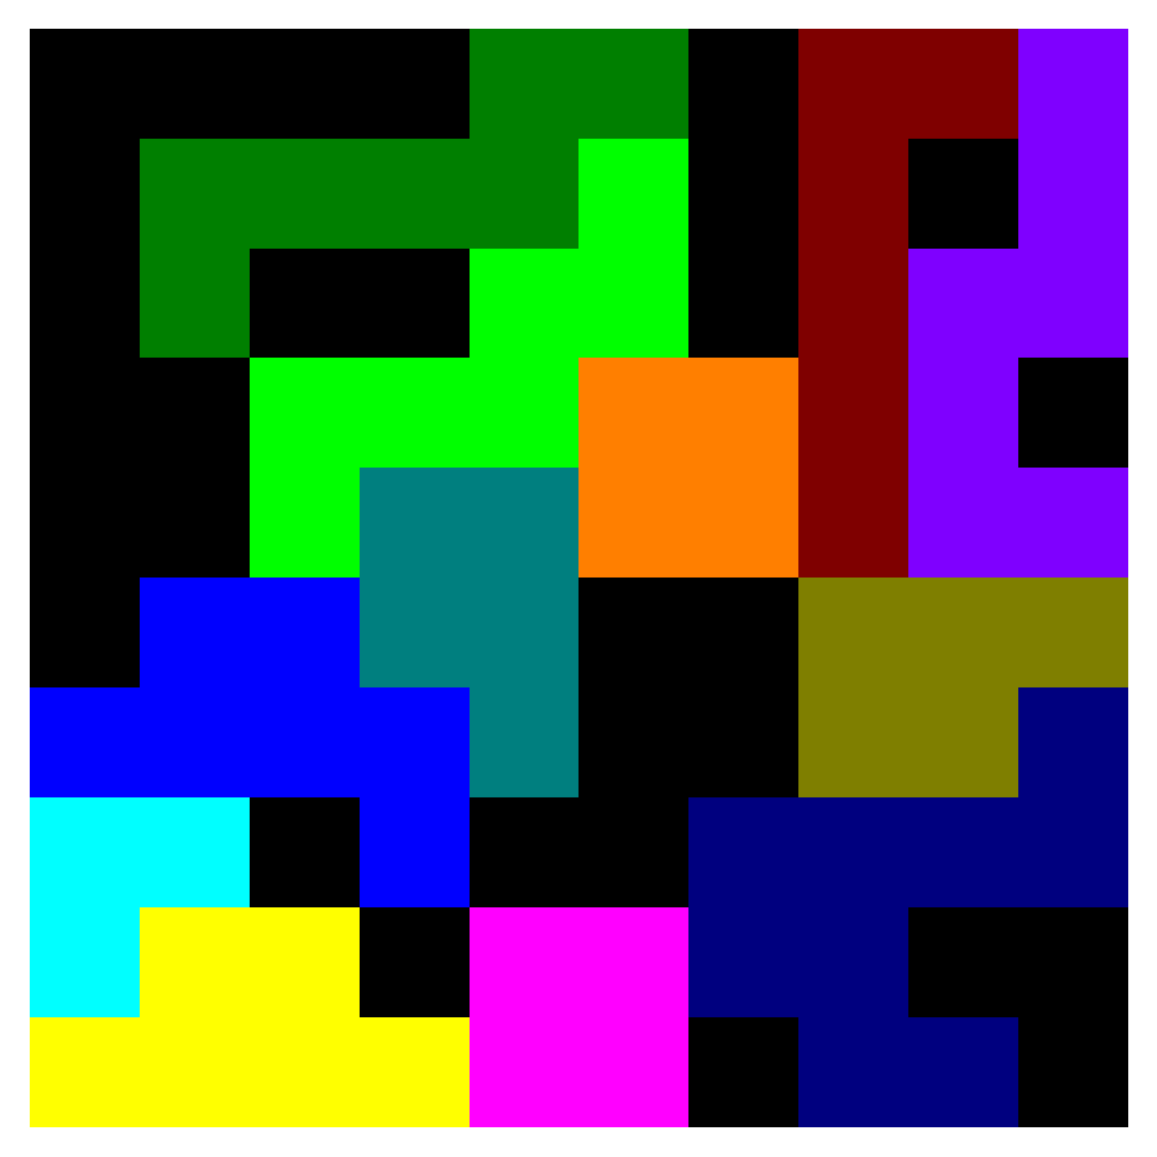
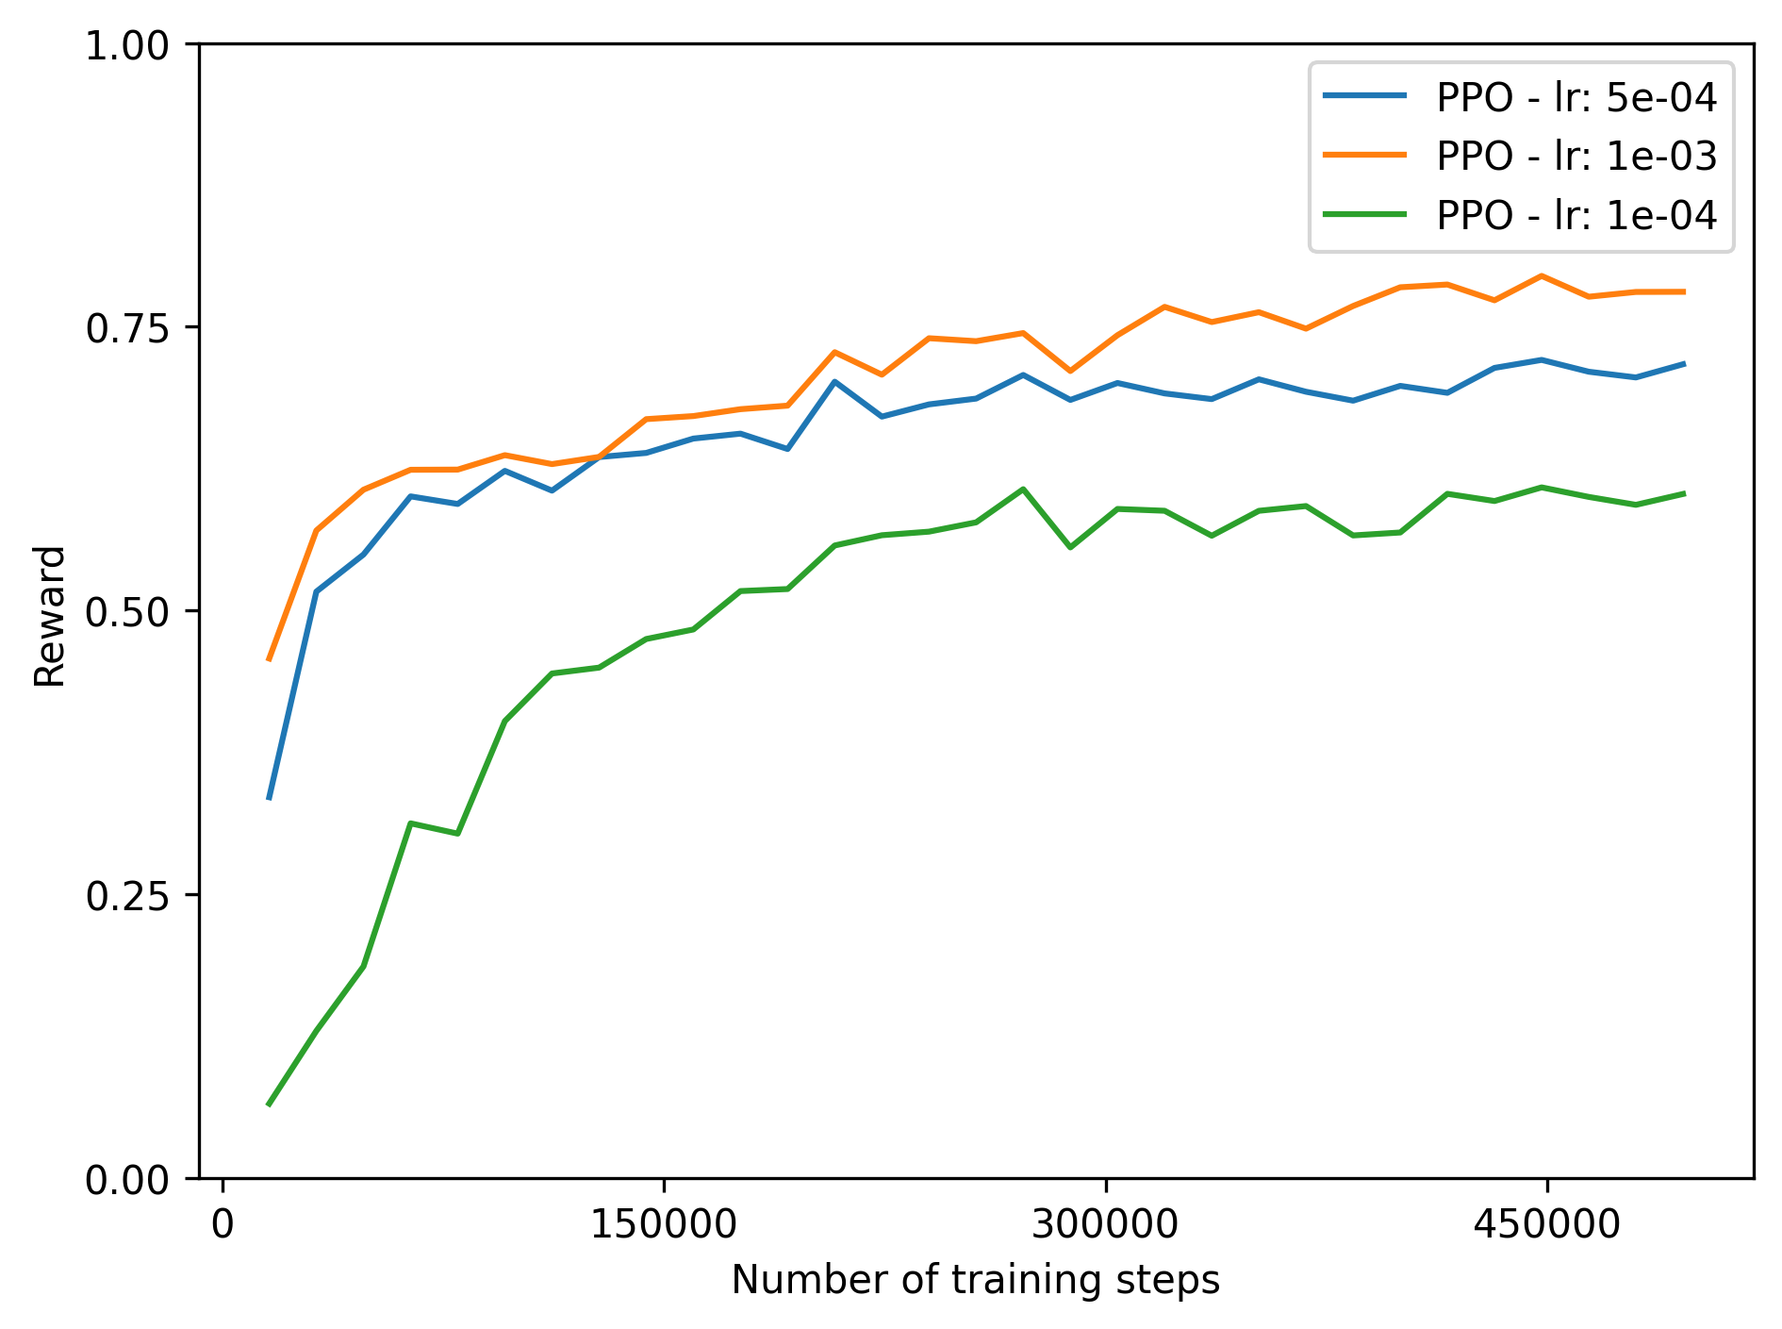
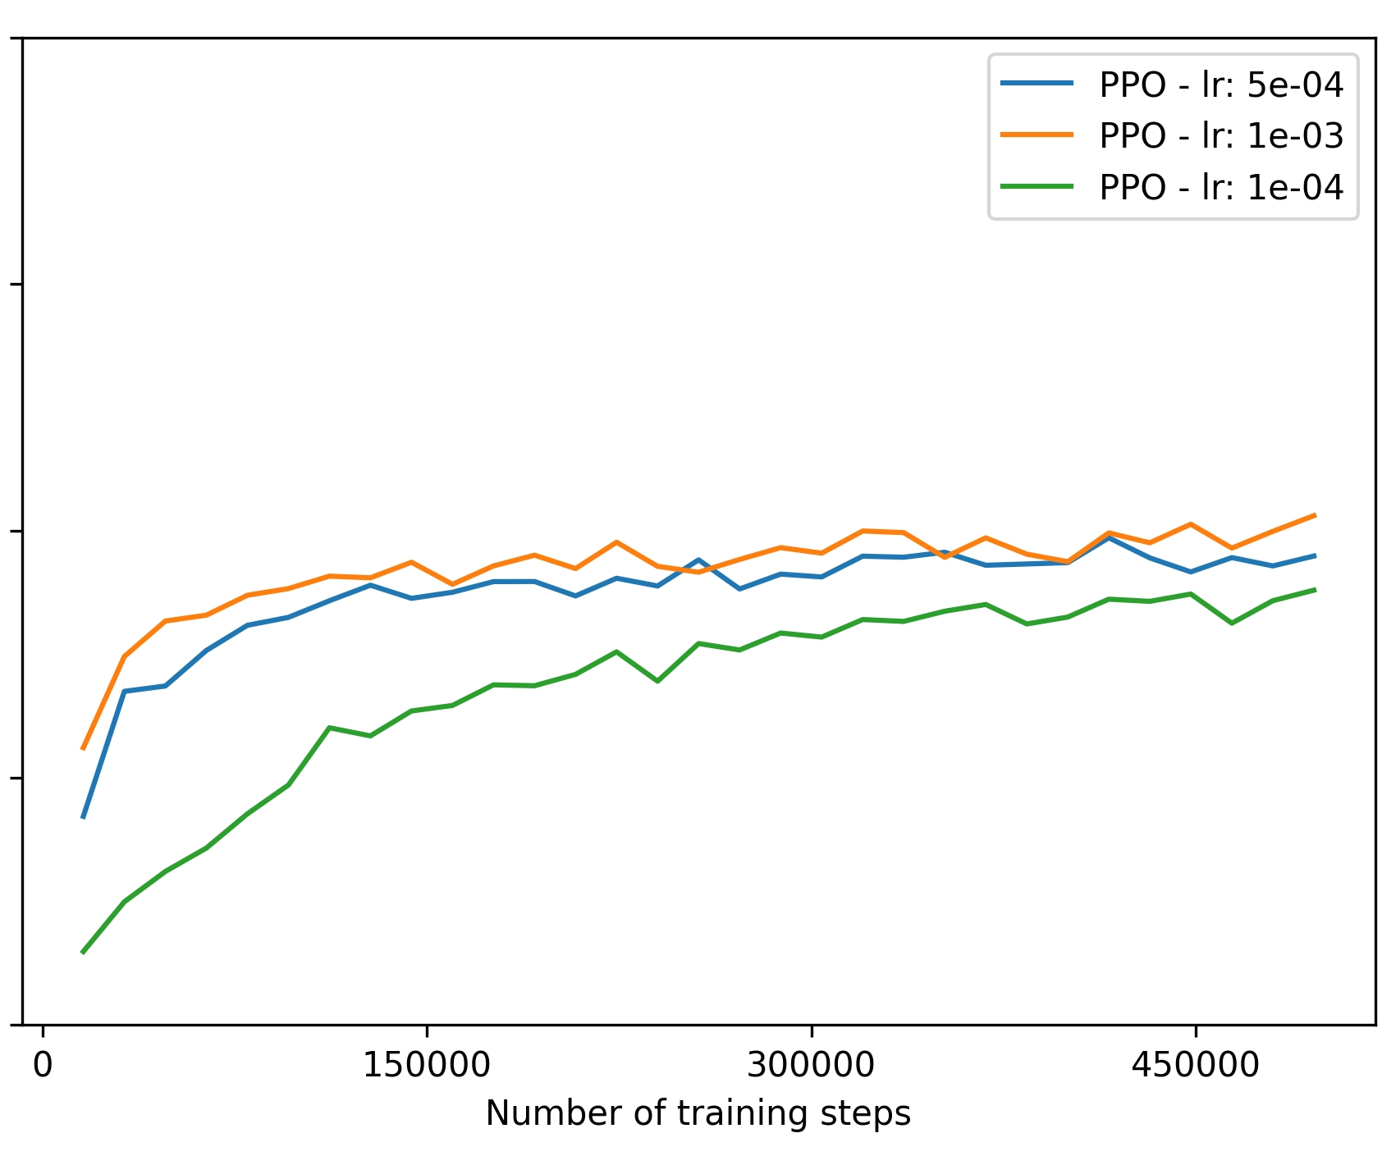
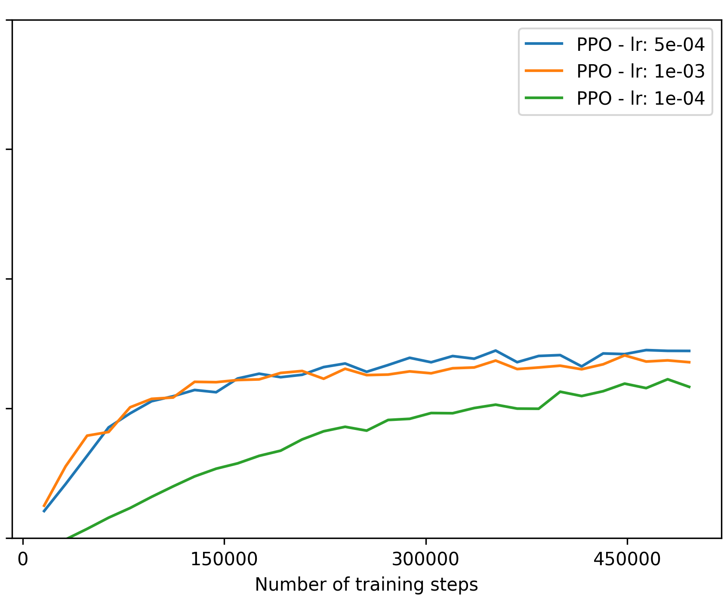
Baseline performance
Random model cumulative reward: -0.11
4x4 grid
6x6 grid
10x10 grid

Slide 7
